Slide 1
MPP-Dairy: Participation Strategies and Integrated Risk Management Program
Marin Bozic
Assistant Professor, Department of Applied Economics
Associate Director, Midwest Dairy Foods Research Center
University of Minnesota
Notes:
Opening slide: remove the Draft: Not for Release statement when we have completed the slide set.

Slide 2
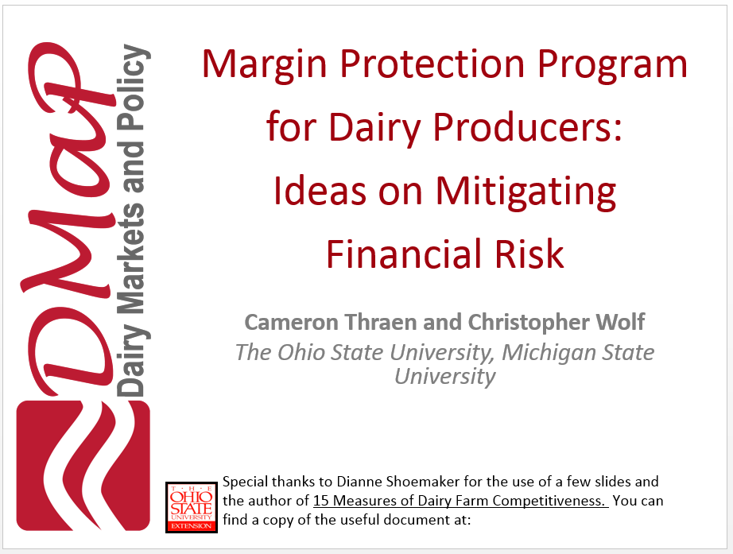
Clarification: This session was given in Syracuse and Atlanta under two different titles, and with slightly different emphasis.
Notes:
Use only when the presentation is stand alone and not already introduced.

Slide 3
Presentation Outline
Dairy risk management: the landscape
Choosing between LGM and MPP
Participation strategies
Profit-maximizing strategies
Risk-minimizing strategies and the role of producer-specific financial data

Slide 4
Dairy Risk Management: The Landscape
2000 – Class III, Class IV futures and options
2005 – cash-settled butter
2007 – dry whey futures and options
2008 – Global Dairy Trade, LGM-Dairy
2010 – cash-settled cheese futures and options
2013 – OTC Class I
Yesterday – OTC MPP IOFC $8.00/$4.00 put spread

Slide 5
Open Interest: All Dairy Futures And Options

Slide 6
How We Came To Talk About Margins…

Slide 7
Margin Risk Management: Options Based
Before we talk about MPP-Dairy and LGM lets quickly review a simple options based strategy for establishing an IOFC floor
Class III put: Establishes minimum milk value
Feed-based equivalent call: Establishes maximum feed cost ($/cwt milk)
Corn
SBM
i.e., Convert feed to corn and SBM equivalents

Slide 8
Margin Risk Management: Options Based
$/cwt
Milk revenue floor
$P* Class III Put
Strike Price→
IOFC** > IOFC < IOFC*
Min.
IOFC
IOFC*
$C* Feed Call
Strike Price→
IOFC**
Feed cost ceiling
$C*
$P*
Market Price/Cost ($/cwt milk)

Slide 9
Margin Risk Management: Options Based
Problems with this strategy
Could by expensive especially in volatile markets
For small operations, contract sizes may be problematic
200,000 & 100,000 lb – Class III (options)
‒ 110/55 cow herds assuming 22,000 lbs/cow
5,000 bu – Corn & Soybeans
100 tons – Soybean Meal
May not be able to undertake desired strategy due to relatively thin Class III options market
Someone must be willing to sell the put option

Slide 10
LGM: An Overview
LGM used to manage IOFC volatility
Establishes minimum IOFC similar to above put/call options strategy
No minimum size limit unlike options contracts
Premium not due until after 11-month insurance period regardless of number of insured months
Known subsidized producer premiums and direct payments to insurance providers

Slide 11
MPP-Dairy and The Use of Other Risk Management Tools
MPP-Dairy enrollment: No impact on ability to use other risk management systems except for Livestock Gross Margin for Dairy (LGM)
Cannot participate in both MPP and LGM
MPP
LGM
Futures
Options

Slide 12
Comparison of MPP-Dairy and LGM
What is the range of margins protected?
MPP-Dairy | LGM
Margin range: $4 to $8/cwt in $0.50 increments Range does not change with milk or feed market conditions | Determined by futures market settlement prices at sign-up
What is the contract coverage period?
MPP-Dairy | LGM
Annual if existing producer Prorated for new operation or 2014/15 transitioning LGM user | Producer determined 2 – 11 months after purchase

Slide 13
Comparison of MPP-Dairy and LGM
How much milk can be insured?
MPP-Dairy | LGM
25% − 90% of operation’s APH Annual increase in APH equals aggregate dairy industry growth rate % of milk covered is the same for all months | 0% – 100% approved target marketings No growth limit on insured milk marketings % milk covered can vary across months Multiple contracts can be used to cover a month’s marketings until 100% insured if desired

Slide 14
Comparison of MPP-Dairy and LGM
When can contracts be purchased?
MPP-Dairy | LGM
May be purchased once a year during designated sign-up period 2014−15: Sep 2nd – Nov 28th 2014 2016−18: June 1 – Last business day of September Once signed-up, in program until end of 2018 | Offered last business Friday monthly starting at 4:30 CDT Producers may sign up 12 times per year given funding availability Offered on first come, first served basis

Slide 15
Comparison of MPP-Dairy and LGM
When are payments/indemnities determined?
MPP-Dairy | LGM
Six bimonthly payment determinations: Jan/Feb Mar/Apr May/Jun Jul/Aug Sept/Oct Nov/Dec | Only 1 indemnity determined per contract regardless of length After last insured month’s actual price announced Period varies with contract specification and months insured

Slide 16
Comparison of MPP-Dairy and LGM
How do premiums compare?
MPP-Dairy | LGM
Fixed rate schedule 25% discount for 2014/15 Vary with (i) margin protected and (ii) milk amount insured → Same premium for same margin target and premium tier for entire 2014 Farm Bill life Do not change with market conditions | Designed to be actuarially fair Premium = 1.03 times expected indemnity at signup Premium independent of insured amt. Vary with (i) market conditions; (ii) declared ration; (iii) deductible; and (iv) margin protected → Premiums vary across farms and over time for same margin → May change with market conditions, ceteris paribus, for same margin target

Slide 17
Comparison of MPP-Dairy and LGM
What are program feed ration characteristics?
MPP-Dairy | LGM
Fixed feed ration All months All operations Feed costs still vary monthly All feed assumed purchased | Operation specific rations May include only purchased feed if desired Ration can vary across months under a single contract → $Cost/cwt may vary across months within a contract

Slide 18
Comparison of MPP-Dairy and LGM
What are program feed ration characteristics?
MPP-Dairy | LGM
Fixed feed ration All months All operations Feed costs still vary monthly All feed assumed purchased | Operation specific rations May include only purchased feed if desired Ration can vary across months under a single contract → $Cost/cwt may vary across months within a contract

Slide 19
Does LGM-Dairy Work?
Policies sold: 3469
Pounds insured (cumulative): 14.96 billion
Premiums paid (producers + USDA): $73.01 million
Indemnities received: $5.02 million
Loss ratio (cumulative): 0.068
Where is the problem?

Slide 20
MPP vs LGM: 2000-2012
Imagine both LGM-Dairy and MPP-Dairy were offered since Jan 2000.
Producer A signs up for MPP-Dairy and chooses the same coverage level every year.
Producer B signs up for LGM-Dairy, buys it every month, and always insures only 3 consecutive months. E.g. 8th, 9th and 10th insurable month.

Slide 21
MPP vs LGM: 2000-2012
LGM | Min Feed | Farm Bill Feed |  | MPP
1-3 | 0.09 | 0.06 |  | $4.50 | 0.05
2-4 | 0.17 | 0.10 |  | $5.00 | 0.08
3-5 | 0.25 | 0.15 |  | $5.50 | 0.11
4-6 | 0.29 | 0.17 |  | $6.00 | 0.14
5-7 | 0.31 | 0.18 |  | $6.50 | 0.18
6-8 | 0.30 | 0.16 |  | $7.00 | 0.21
7-9 | 0.30 | 0.15 |  | $7.50 | 0.19
8-10 | 0.29 | 0.12 |  | $8.00 | 0.23

Slide 22
MPP vs LGM in 2009
LGM | Min Feed | Farm Bill Feed |  | MPP
1-3 | 0.72 | 0.65 |  | $4.50 | 0.42
2-4 | 1.26 | 0.96 |  | $5.00 | 0.75
3-5 | 2.00 | 1.28 |  | $5.50 | 1.07
4-6 | 2.66 | 1.51 |  | $6.00 | 1.38
5-7 | 3.23 | 1.77 |  | $6.50 | 1.72
6-8 | 3.62 | 1.94 |  | $7.00 | 2.10
7-9 | 3.85 | 2.02 |  | $7.50 | 2.39
8-10 | 4.02 | 2.09 |  | $8.00 | 2.73

Slide 23
So what was the problem with LGM?
Limited budget for subsidies. Once exhausted, no LGM sales events until next fiscal year.
Not regularly offered.
Premiums for high-feed policies are too high as the contract design stipulates zero milk-feed correlation.

Slide 24
Will MPP change how we use futures and options?
Before we answer that question, we must review what were principles of successful dairy risk management prior to MPP-Dairy….

Slide 25
A simple hedging program with puts
Hedging Horizon | What Can You Buy for 50 cents? (Option Strike)
1 month | 5 cents below futures
3 months | 64 cents below futures
5 months | 1.08 below futures
7 months | 1.44 below futures
9 months | 1.74 below futures
11 months | 2.08 below futures

Slide 26
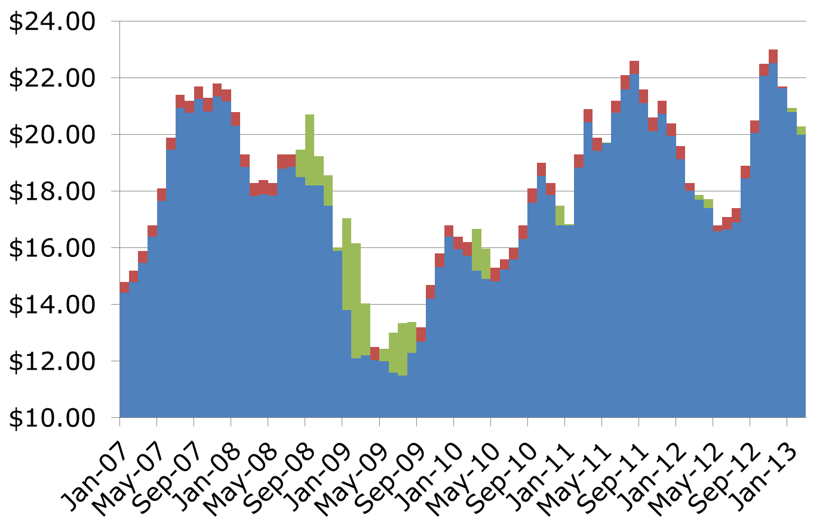
Hedging with Puts: 3-months Out

Slide 27
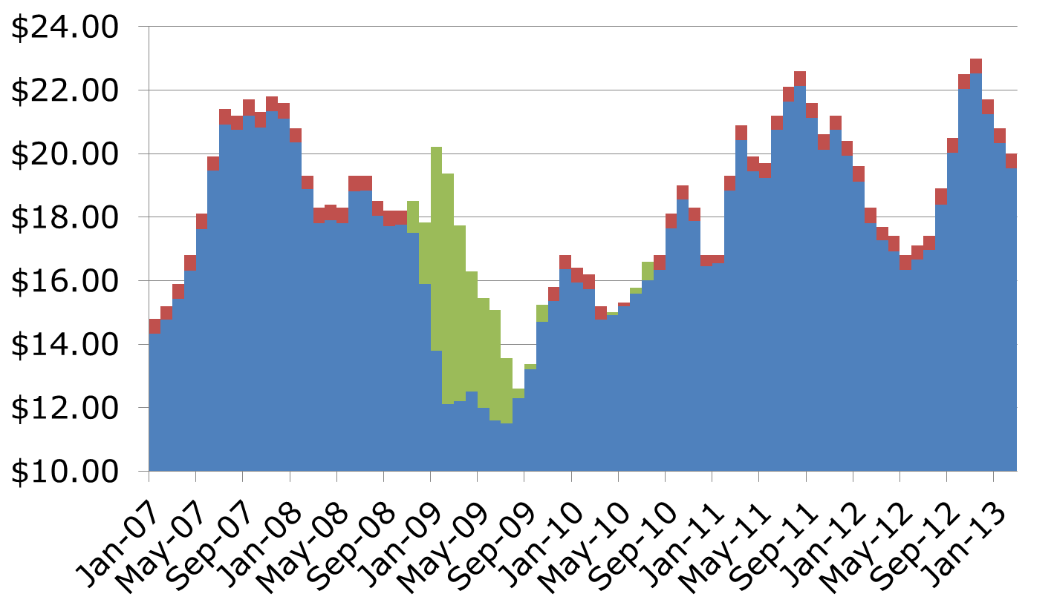
Hedging with Puts: 7-months Out

Slide 28
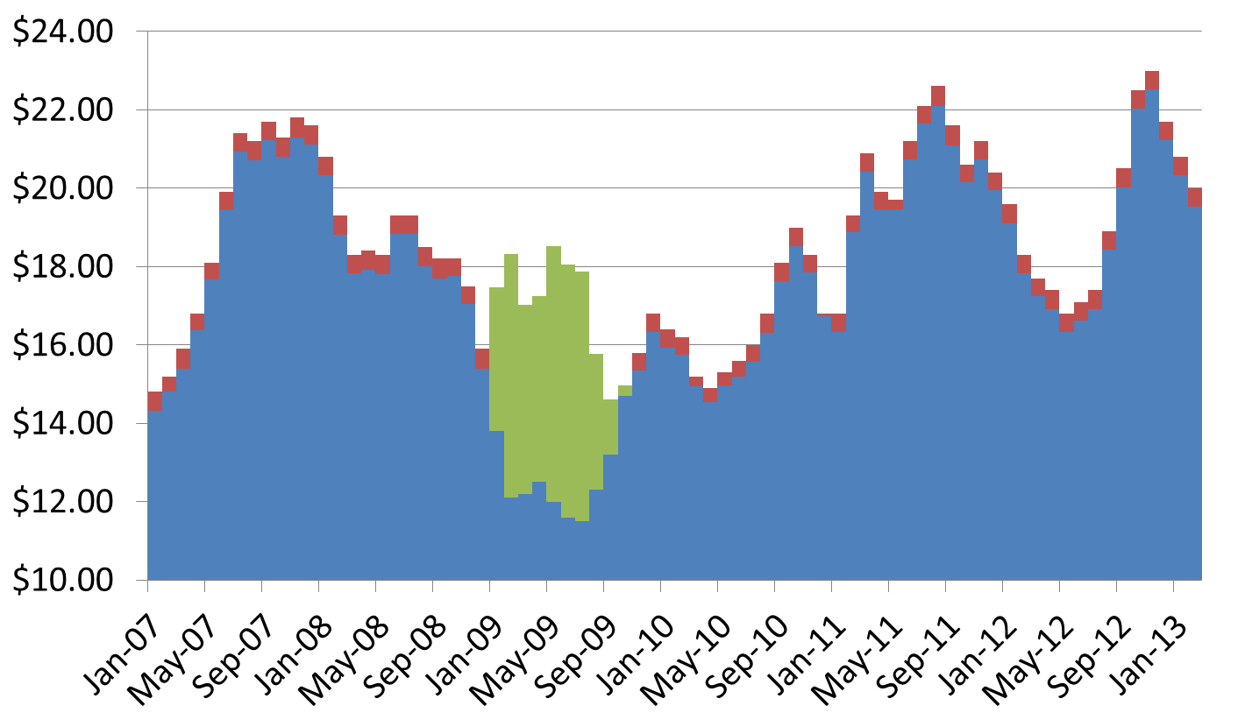
Hedging with Puts: 11-months Out

Slide 29
A simple hedging program with puts
Hedging Horizon | Number of Profitable Trades | Net Profit/Loss 2007-2012 | Return on Investment 2007-2012
1 month | 16/74 | -0.14 | -41%
3 months | 21/74 | 0.06 | 13%
5 months | 19/74 | 0.21 | 46%
7 months | 15/74 | 0.24 | 52%
9 months | 09/74 | 0.26 | 57%
11 months | 10/74 | 0.33 | 73%

Slide 30
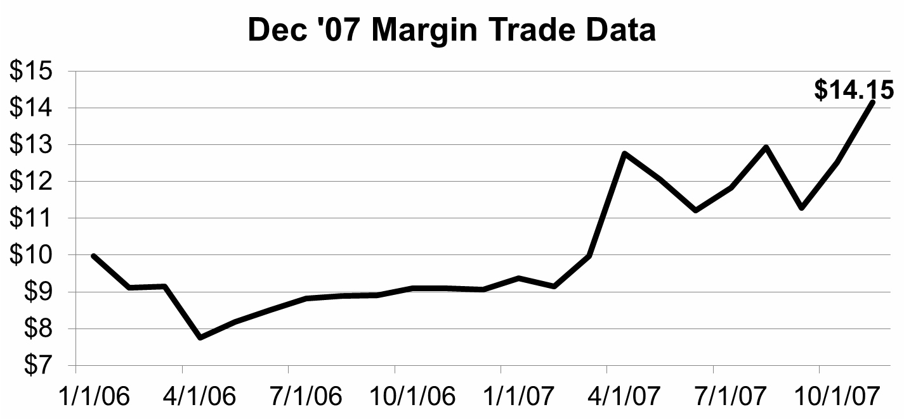
Hedge early, hedge often

Slide 31
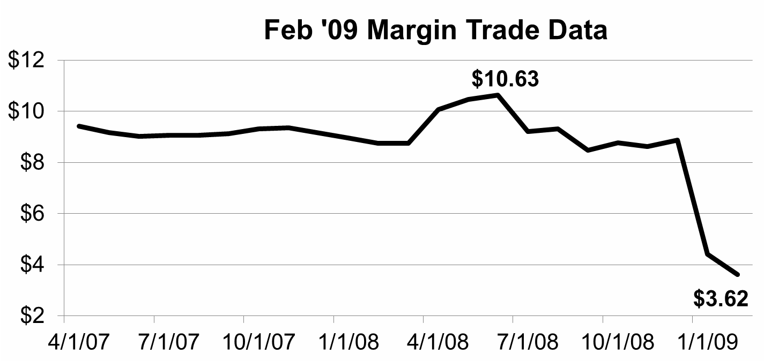
Hedge early, hedge often

Slide 32
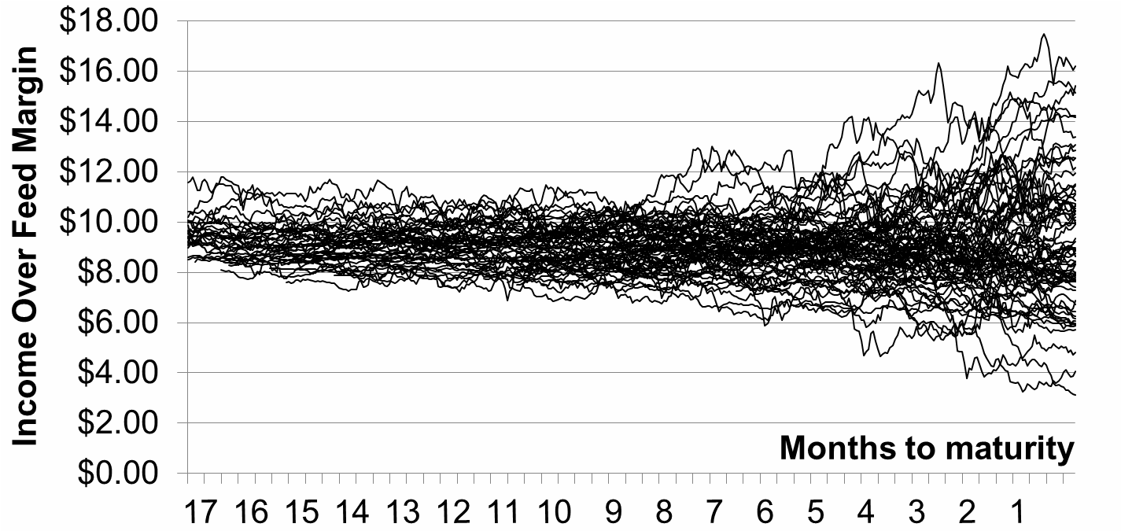
Hedge early, hedge often

Slide 33
Will MPP change how we use futures and options?
With MPP-Dairy in place, you no longer have to start very early because MPP-Dairy provides a backstop in case you do not manage to find good margins on the CME.
Crowding out? 20-30 percent of producers report MPP-Dairy will “somewhat” reduce their use of other risk management tools. Survey results to be released next week.

Slide 34
MPP-Dairy Participation Strategies
Based on program design. Fixed premiums imply MPP-Dairy will sometimes be a good instrument to enhance farm profitability.
Based on producer’s risk averseness, and risk-bearing capacity.

Slide 35
MPP-Dairy Participation Strategies: 1. Enhancing Profitability
Expected Margins Much Below Historical Average
Expected Margins Near Historical Average
Expected Margins Much Above Historical Average
Margin Insurance Premiums are Very Highly Subsidized.
Modestly Subsidized.
Margin Insurance Premiums are Too Expensive!

Slide 36
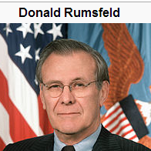
MPP-Dairy Participation Strategies: Risk Protection
Assessing the likelihood and potential impact of adverse events
Rumsfeld Whammy: The Unknown Unknowns ?
Using MPP to develop contingency plans to deal with UU events !

Slide 37
MPP-Dairy Participation Strategies: Risk Protection – Simple Version
Coverage Level | Premium ≤ 4mil lbs PH ($/cwt) | Premium >4 M lbs. PH ($/cwt)
$4.00 | $0.00000 | $0.000
$4.50 | $0.00750 | $0.020
$5.00 | $0.01875 | $0.040
$5.50 | $0.03000 | $0.100
$6.00 | $0.04125 | $0.155
$6.50 | $0.06750 | $0.290
$7.00 | $0.16250 | $0.830
$7.50 | $0.22500 | $1.060
$8.00 | $0.47500 | $1.360

Slide 38
MPP-Dairy Payments: $5.50 Coverage Level

Slide 39
MPP-Dairy Payments: $6.50 Coverage Level

Slide 40
MPP-Dairy vs MILC

Slide 41
MPP-Dairy Participation Strategies: Risk Protection – Complex Version
Category | Budget
Costs of Production | $17.00
Feed Costs | $7.45
Herd Replacement and Other Operating Costs | $9.55
Revenue Per Cwt | $18.50
Budgeted Farm IOFC | $11.05
??? | ???
Needed MPP Coverage Level to cover Costs of Production | ???

Slide 42
MPP-Dairy Participation Strategies: Risk Protection – Complex Version
To protect ALL costs of production, needed farm IOFC = herd replacement and other operating costs per cwt.
In our example, needed IOFC = $9.55/cwt
If MPP basis is $2.50, then when your margin is $9.55, MPP margin will be $9.55-$2.50 = $7.05.
Finally, because you can only protect 90% with MPP, needed MPP Coverage Level is $7.05/90% = $7.83

Slide 43
MPP-Dairy Participation Strategies: Risk Protection – Complex Version
Category | Budget
Costs of Production | $17.00
Feed Costs | $7.45
Herd Replacement and Other Operating Costs | $9.55
Revenue Per Cwt | $18.50
Budgeted Farm IOFC | $11.05
MPP Basis (Farm IOFC – MPP IOFC) | $2.50
Needed MPP Coverage Level to cover Costs of Production | $8.00

Slide 44
MPP-Dairy Participation Strategies: Risk Protection – Complex Version
There are two questions that need to ask at this point:
How do we estimate the appropriate MPP Basis?
How should farm financial situation influence the MPP coverage decision?

Slide 45
MPP Basis – Which One to Use?
Year | Net Farm Income | Feed Costs | Revenue Per Cwt | Actual Farm IOFC | MPP IOFC | MPP Basis
2009 | -2.45 | 7.45 | 14.90 | 7.45 | 4.58 | 2.87
2010 | 1.06 | 6.96 | 17.78 | 10.82 | 8.25 | 2.57
2011 | 2.87 | 8.74 | 21.25 | 12.51 | 8.82 | 3.69
2012 | 1.34 | 9.92 | 20.65 | 10.73 | 5.31 | 5.42
2013 | 0.30 | 11.50 | 21.14 | 9.64 | 7.19 | 2.45
Avg |  |  |  |  |  | 3.40

Slide 46
Net Farm Income Loss and Debt-to-Assets Changes
Farm A has a lot of land and grows most of their feed needs. Their assets per cwt is 50.
Farm B has some land, but contracts for a fair amount of their feed needs. Their assets per cwt is 25.
What is the net farm income loss per cwt that would increase debt-to-assets ratio by 0.1 on each of these farms?
On farm A: $5.00/cwt On farm B: $2.50/cwt

Slide 47
How Much Loss Can Be Tolerated?
What is the highest debt-to-assets ratio that a farm would be willing to tolerate?
What is the current debt-to-assets ratio?
How big are total assets relative to milk marketings? I.e. what is assets-per-cwt ratio?

Slide 48
How Much Loss Can Be Tolerated?
Tolerated Debt-to-Assets | Current Debt-to-Assets | Assets /Cwt | NFI Loss that Increases Debt-to-Assets by 0.1 | NFI Loss Tolerated
0.50 | 0.45 | 25 | 2.50 | 1.25
0.50 | 0.40 | 25 | 2.50 | 2.50
0.50 | 0.45 | 50 | 5.00 | 2.50
0.50 | 0.40 | 50 | 5.00 | 5.00

Slide 49
How Much Loss Can Be Tolerated?
Tolerated Debt-to-Assets | Current Debt-to-Assets | Assets /Cwt | NFI Loss that Increases Debt-to-Assets by 0.1 | NFI Loss Tolerated | MPP CL to fully protect COP | MPP CL given tolerance for losses
0.50 | 0.45 | 25 | 2.50 | 1.25 | $7.83 | $6.58
0.50 | 0.40 | 25 | 2.50 | 2.50 | $7.83 | $5.33
0.50 | 0.45 | 50 | 5.00 | 2.50 | $7.83 | $5.33
0.50 | 0.40 | 50 | 5.00 | 5.00 | $7.83 | $4.00*

Slide 50
Data Source for This Exercise
Genske, Mulder and Co.
Average Income and Expenses
Upper Midwest Dairy Clients
2009, 2010, 2011, 2012 and Q3/2013.
Special thanks to Mr. Gary Vande Vegte
http://www.vbandvv.com/
…and to AgStar Financial Services for letting me shadow them in meetings with some clients.

Slide 51
For More Information on LGM-Dairy and Use of Farm Financial Ratios:
Notes:
Use only when the presentation is stand alone and not already introduced.

